Slide 1
Report batch 20230427_MW41

Slide 2
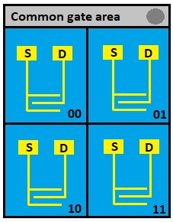
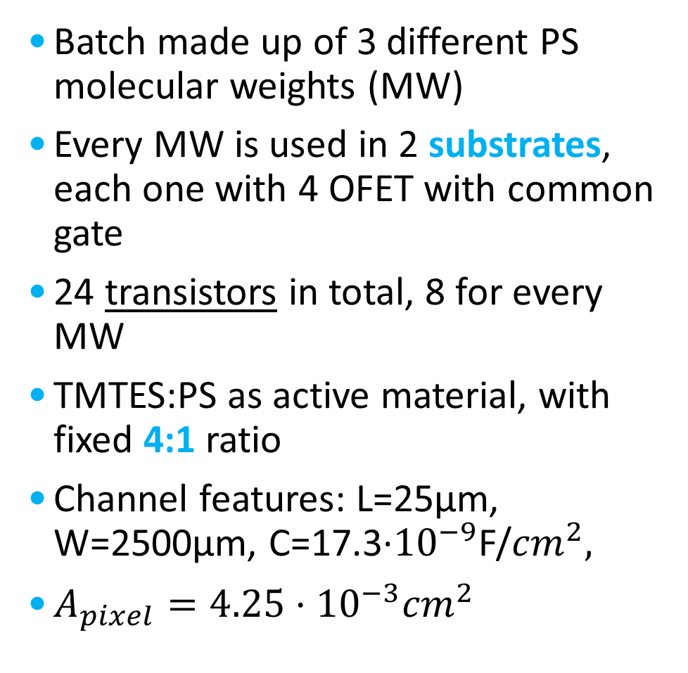
General features
Batch made up of 3 different PS molecular weights (MW)
Every MW is used in 2 substrates, each one with 4 OFET with common gate
24 transistors in total, 8 for every MW
TMTES:PS as active material, with fixed 4:1 ratio
Channel features: L=25µm, W=2500µm, C=17.3·${10}^{−9}$F/${cm}^{2},$
$A_{pixel}={4.25·10}^{−3}{cm}^{2}$

Slide 3
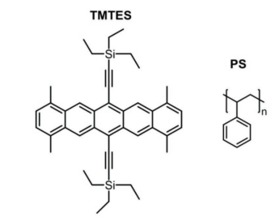
Compositions
TMTES:PS ratio is fixed at 4:1, but the molecular weight of PS (a polymer with variable chain length) is varied
280K: Sample5 and Sample6
100K: Sample11 and Sample12
10K: Sample17 and Sample18
Tamayo A., Fratelli I., Ciavatti A., Martínez-Domingo C., Branchini P., Colantoni E., de Rosa S., Tortora L., Contillo A., Santiago R., Bromley S. T., Fraboni B., Mas-Torrent M., Basiricò L., X-ray Detectors With Ultrahigh Sensitivity Employing High Performance Transistors Based on a Fully Organic Small Molecule Semiconductor/Polymer Blend Active, 2022

Slide 4
X-rays measurements: Current normalization
Polynomial fit before irradiation

Slide 5
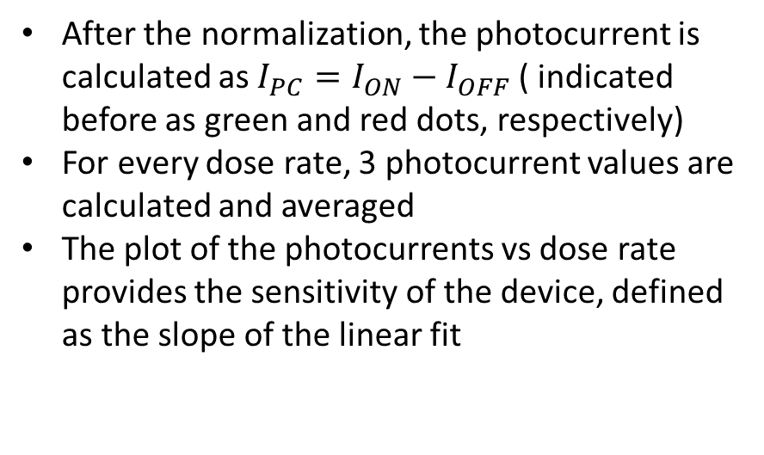
X-rays measurements: sensitivity calculation
After the normalization, the photocurrent is calculated as ${I_{PC}=I}_{ON}−I_{OFF}$ ( indicated before as green and red dots, respectively)
For every dose rate, 3 photocurrent values are calculated and averaged
The plot of the photocurrents vs dose rate provides the sensitivity of the device, defined as the slope of the linear fit

Slide 6
280K samples

Slide 7

280K samples
Transfer characteristics
Output characteristic (example)
:Working point ($V_{SG}=−2.5V, V_{SD}=−10V$)

Slide 8
280K: Current curves

Slide 9
280K: Photocurrent

Slide 10
280K: Transfer characteristic

Slide 11
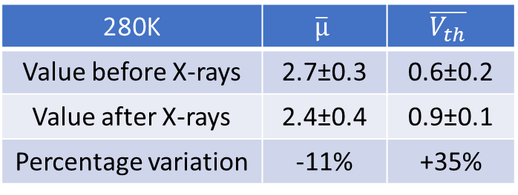
280K: Transfer before and after X-rays
280K | $$\overline{µ}$$ | $$\overline{V_{th}}$$
Value before X-rays | 2.7±0.3 | 0.6±0.2
Value after X-rays | 2.4±0.4 | 0.9±0.1
Percentage variation | -11% | +35%

Slide 12
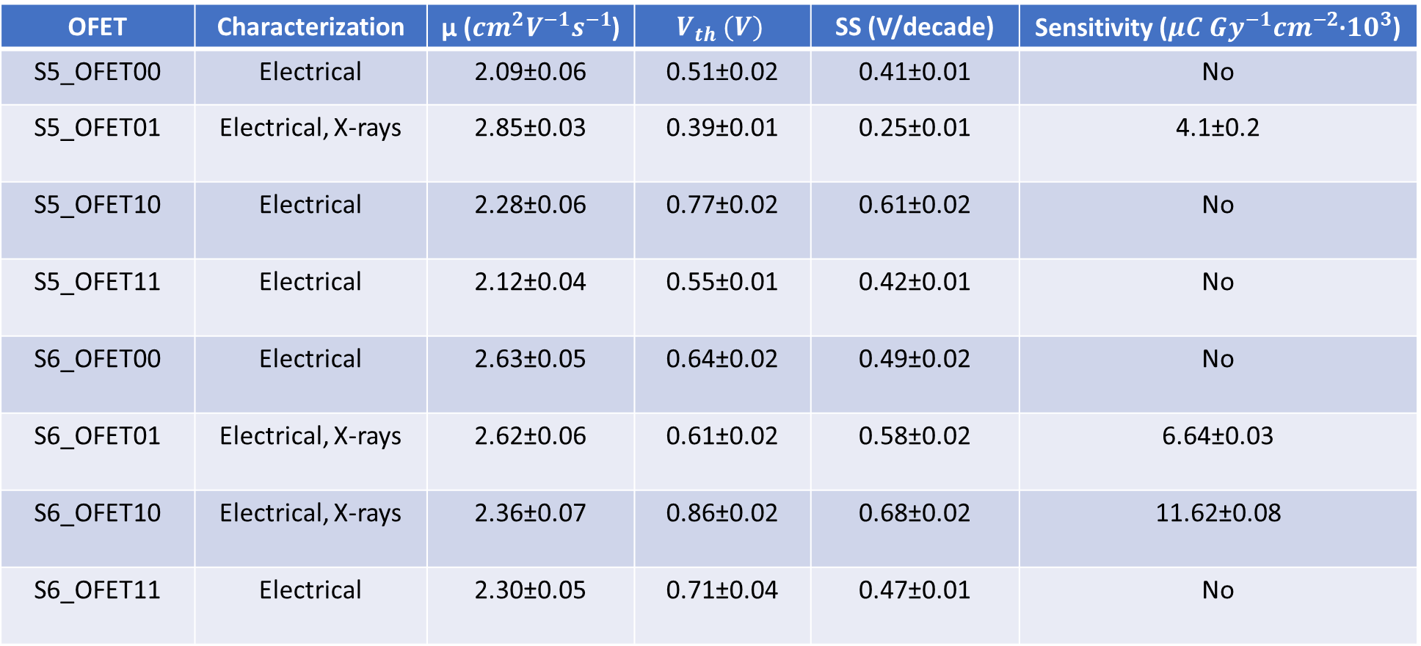
Summary table: 280K
OFET | Characterization | µ (${cm}^{2}V^{−1}s^{−1}$) | $$V_{th} (V)$$ | SS (V/decade) | Sensitivity (${{μC Gy}^{−1}cm}^{−2}$·${10}^{3}$)
S5_OFET00 | Electrical | 2.09±0.06 | 0.51±0.02 | 0.41±0.01 | No
S5_OFET01 | Electrical, X-rays | 2.85±0.03 | 0.39±0.01 | 0.25±0.01 | 4.1±0.2
S5_OFET10 | Electrical | 2.28±0.06 | 0.77±0.02 | 0.61±0.02 | No
S5_OFET11 | Electrical | 2.12±0.04 | 0.55±0.01 | 0.42±0.01 | No
S6_OFET00 | Electrical | 2.63±0.05 | 0.64±0.02 | 0.49±0.02 | No
S6_OFET01 | Electrical, X-rays | 2.62±0.06 | 0.61±0.02 | 0.58±0.02 | 6.64±0.03
S6_OFET10 | Electrical, X-rays | 2.36±0.07 | 0.86±0.02 | 0.68±0.02 | 11.62±0.08
S6_OFET11 | Electrical | 2.30±0.05 | 0.71±0.04 | 0.47±0.01 | No
$\overline{µ}=(\text{2.4}\text{±}0.3){cm}^{2}V^{−1}s^{−1}, \overline{V_{th}}=\left(0.\text{6}\text{±}0.2\right) V, \overline{SS}=\left(0.\text{5}\text{±}0.1\right)V/decade$, $\overline{S}=(7.4±3.8)µC{Gy}^{−1}{cm}^{−2}{•10}^{3}$

Slide 13
100K samples

Slide 14

100K samples
Transfer characteristics
Output characteristic (example)
:Working point ($V_{SG}=−2.5V, V_{SD}=−10V$)

Slide 15
100K: Current curves

Slide 16
100K: Photocurrent

Slide 17
100K: Transfer characteristic

Slide 18
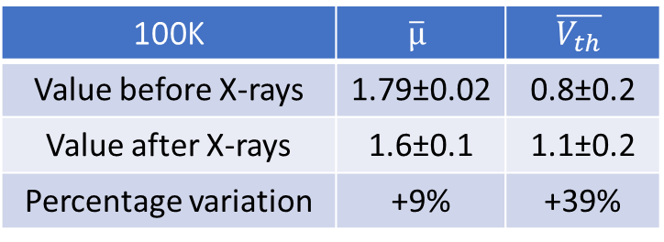
100K: Transfer before and after X-rays
100K | $$\overline{µ}$$ | $$\overline{V_{th}}$$
Value before X-rays | 1.79±0.02 | 0.8±0.2
Value after X-rays | 1.6±0.1 | 1.1±0.2
Percentage variation | +9% | +39%

Slide 19
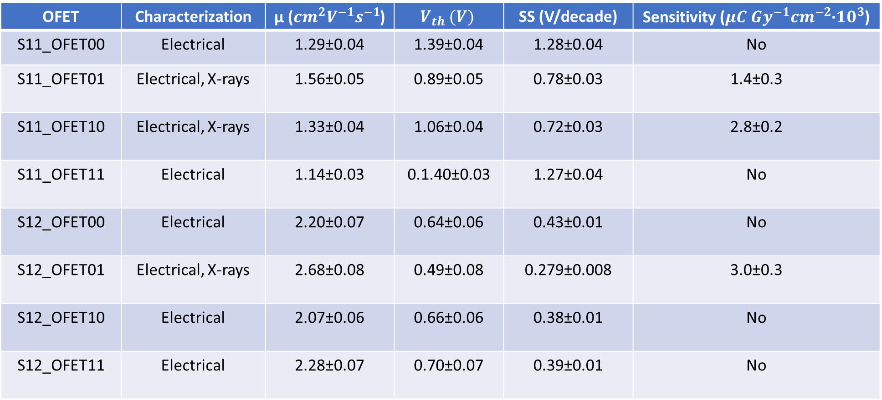
Summary table: 100K
OFET | Characterization | µ (${cm}^{2}V^{−1}s^{−1}$) | $$V_{th} (V)$$ | SS (V/decade) | Sensitivity (${{μC Gy}^{−1}cm}^{−2}$·${10}^{3}$)
S11_OFET00 | Electrical | 1.29±0.04 | 1.39±0.04 | 1.28±0.04 | No
S11_OFET01 | Electrical, X-rays | 1.56±0.05 | 0.89±0.05 | 0.78±0.03 | 1.4±0.3
S11_OFET10 | Electrical, X-rays | 1.33±0.04 | 1.06±0.04 | 0.72±0.03 | 2.8±0.2
S11_OFET11 | Electrical | 1.14±0.03 | 0.1.40±0.03 | 1.27±0.04 | No
S12_OFET00 | Electrical | 2.20±0.07 | 0.64±0.06 | 0.43±0.01 | No
S12_OFET01 | Electrical, X-rays | 2.68±0.08 | 0.49±0.08 | 0.279±0.008 | 3.0±0.3
S12_OFET10 | Electrical | 2.07±0.06 | 0.66±0.06 | 0.38±0.01 | No
S12_OFET11 | Electrical | 2.28±0.07 | 0.70±0.07 | 0.39±0.01 | No
$\overline{µ}=\text{(1.8}\text{±}\text{0.}6){cm}^{2}V^{−1}s^{−1}, \overline{V_{th}}=\left(0.9±0.3\right) V, \overline{SS}=\left(0.7±0.4\right)V/decade$, $\overline{S}=(2.4±0.8)µC{Gy}^{−1}{cm}^{−2}{•10}^{3}$

Slide 20
10K samples

Slide 21

10K samples
Transfer characteristics
Output characteristic (example)
:Working point ($V_{SG}=−2.5V, V_{SD}=−10V$)

Slide 22
10K: Current curves

Slide 23
10K: Photocurrent

Slide 24
10K: Transfer characteristic

Slide 25
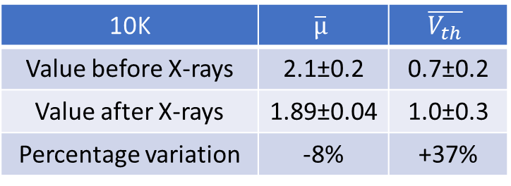
10K: Transfer before and after X-rays
10K | $$\overline{µ}$$ | $$\overline{V_{th}}$$
Value before X-rays | 2.1±0.2 | 0.7±0.2
Value after X-rays | 1.89±0.04 | 1.0±0.3
Percentage variation | -8% | +37%

Slide 26
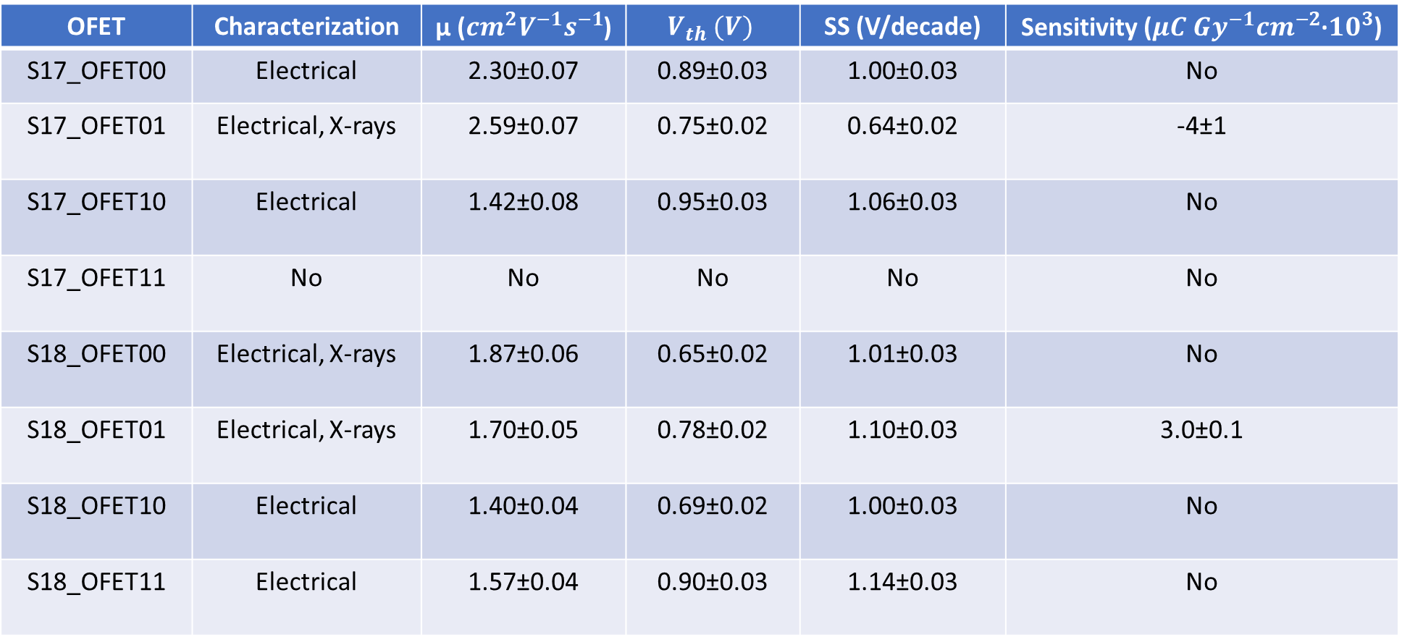
Summary table: 10K
OFET | Characterization | µ (${cm}^{2}V^{−1}s^{−1}$) | $$V_{th} (V)$$ | SS (V/decade) | Sensitivity (${{μC Gy}^{−1}cm}^{−2}$·${10}^{3}$)
S17_OFET00 | Electrical | 2.30±0.07 | 0.89±0.03 | 1.00±0.03 | No
S17_OFET01 | Electrical, X-rays | 2.59±0.07 | 0.75±0.02 | 0.64±0.02 | -4±1
S17_OFET10 | Electrical | 1.42±0.08 | 0.95±0.03 | 1.06±0.03 | No
S17_OFET11 | No | No | No | No | No
S18_OFET00 | Electrical, X-rays | 1.87±0.06 | 0.65±0.02 | 1.01±0.03 | No
S18_OFET01 | Electrical, X-rays | 1.70±0.05 | 0.78±0.02 | 1.10±0.03 | 3.0±0.1
S18_OFET10 | Electrical | 1.40±0.04 | 0.69±0.02 | 1.00±0.03 | No
S18_OFET11 | Electrical | 1.57±0.04 | 0.90±0.03 | 1.14±0.03 | No
$\overline{µ}=\text{(1.8}\text{±}\text{0.}5){cm}^{2}V^{−1}s^{−1}, \overline{V_{th}}=\left(0.8±0.1\right) V, \overline{SS}=\left(1.0±0.2\right)V/decade$, $\overline{S}=(3.0±0.1)µC{Gy}^{−1}{cm}^{−2}{•10}^{3}$

Slide 27
Composition comparisons

Slide 28
Transfer characteristic
Samples with 280K molecular weight show a better transfer characteristic than 100K and 10K
This leads to values of mobility, threshold voltage and SS closer to ideality for 280K samples (next graphs)

Slide 29
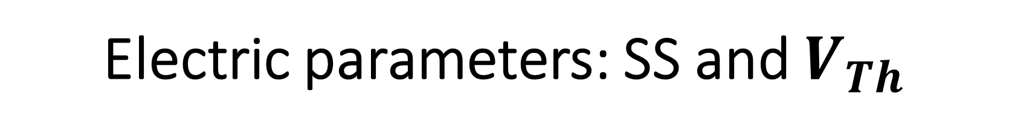
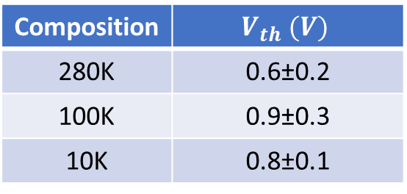
Electric parameters: SS and $V_{Th}$
Composition | SS (V/decade)
280K | 0.5±0.1
100K | 0.7±0.4
10K | 1.0±0.2
Composition | $$V_{th} (V)$$
280K | 0.6±0.2
100K | 0.9±0.3
10K | 0.8±0.1

Slide 30
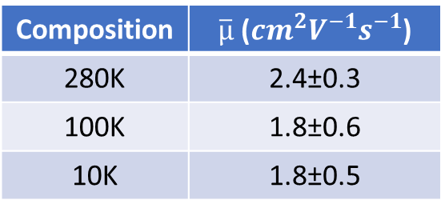
Electric parameters: mobility
Composition | $\overline{µ}$ (${cm}^{2}V^{−1}s^{−1}$)
280K | 2.4±0.3
100K | 1.8±0.6
10K | 1.8±0.5

Slide 31
X-rays detection: currents in time
In both compositions, the current initially drops (more quickly in 10K)
As irradiation takes place, the current starts to rise again
Sensitivity is higher in samples where current increase is slower (right image)

Slide 32
X-rays detection: normalized currents
Higher stability in response for 280K samples
Higher sensitivities in samples where normalized currents are never negative

Slide 33
X-rays detection: sensitivities
280K and 100K sensitivity were evaluated from three samples, whereas just one sample provided a reliable value for 10K (left graph)
Graph on the right: «negative» sensitivity from 10K sample
280K samples sensitivity are almost three times higher than 100K and 10K ones

Slide 34
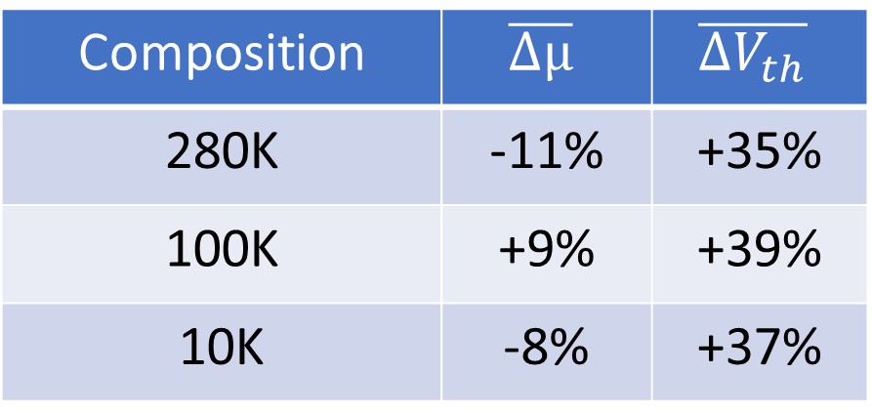
Resume on electical parameters variation after X-rays irradiation
Composition | $$\overline{Δµ}$$ | $$\overline{{ΔV}_{th}}$$
280K | -11% | +35%
100K | +9% | +39%
10K | -8% | +37%

Slide 35
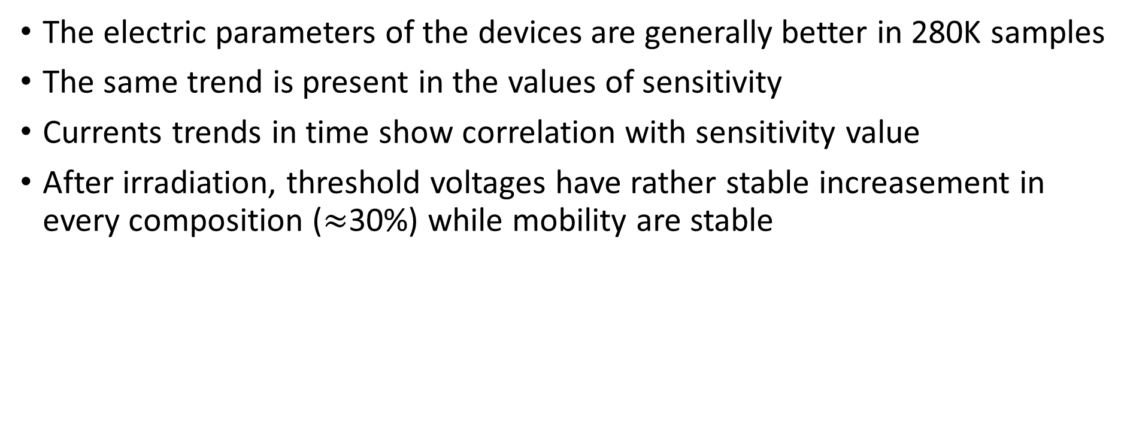
Conclusions
The electric parameters of the devices are generally better in 280K samples
The same trend is present in the values of sensitivity
Currents trends in time show correlation with sensitivity value
After irradiation, threshold voltages have rather stable increasement in every composition ($≈$30%) while mobility are stable

